Slide 1

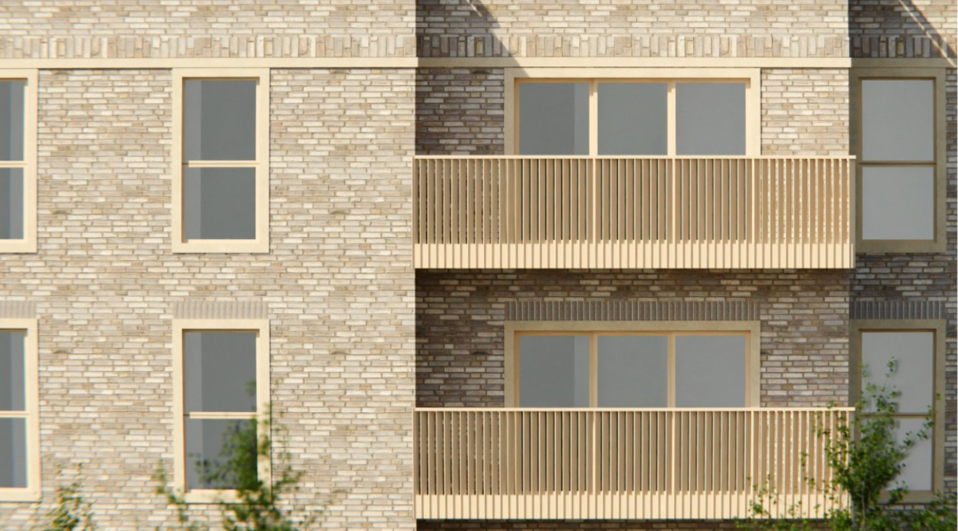
High-quality new homes for Blackheath

Slide 2
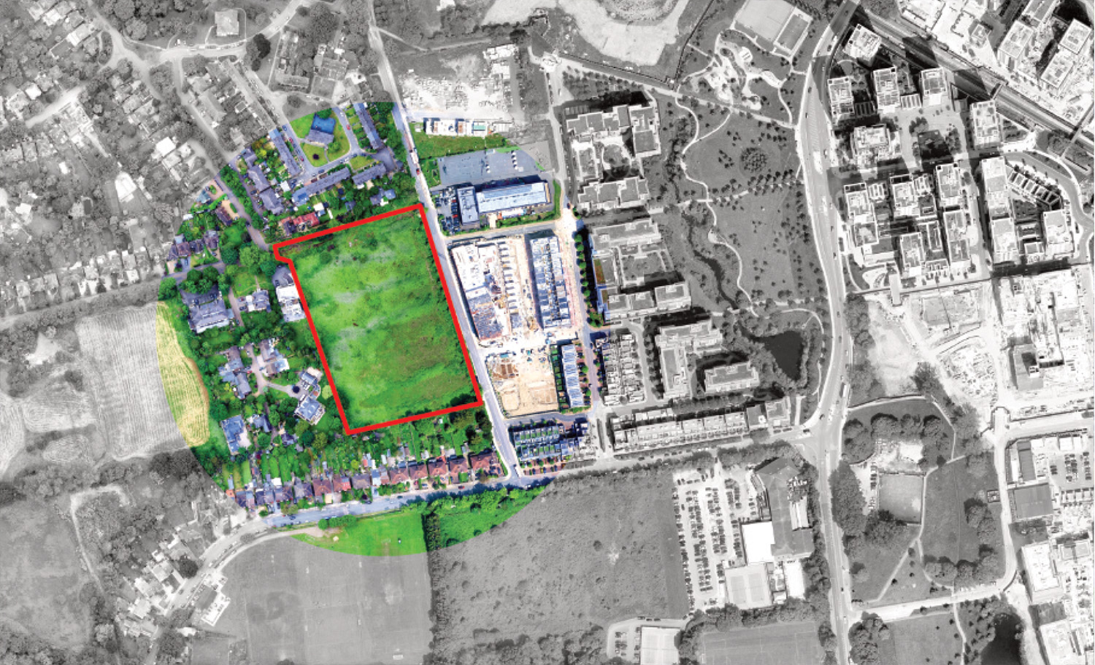
The site
Above: Aerial view of the site

Slide 3
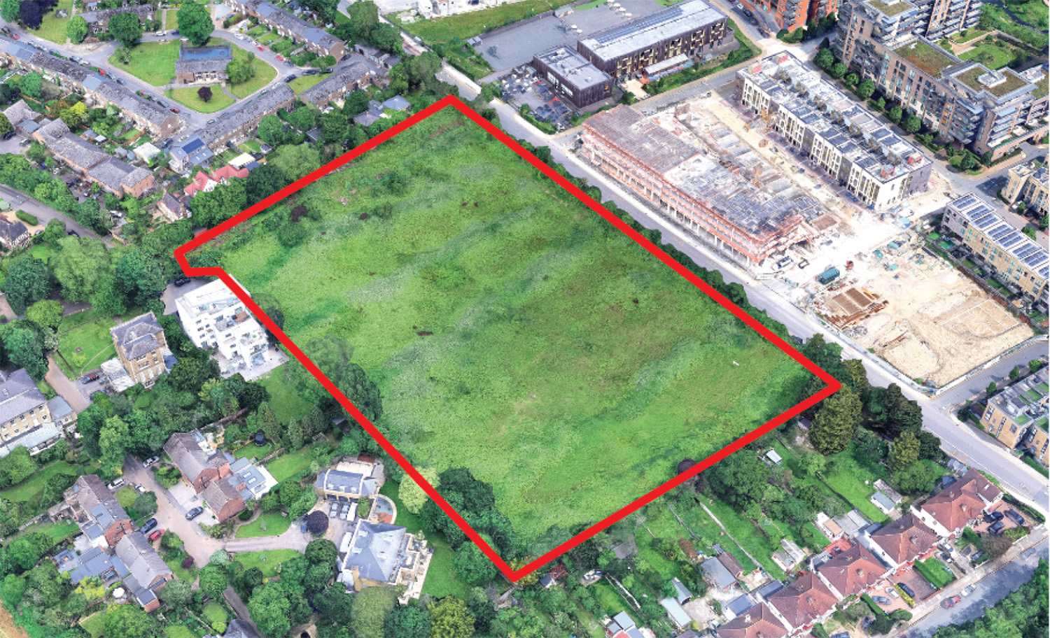
The site
Above: Aerial view of the site

Slide 4
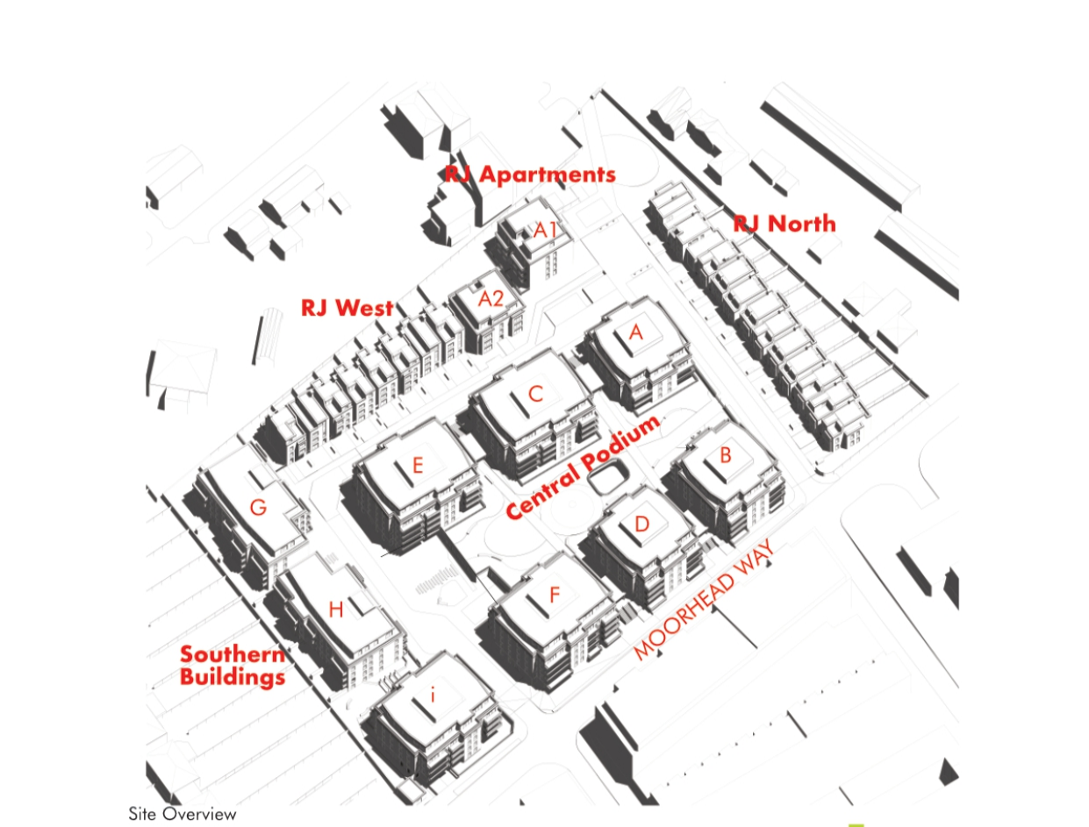
Proposed site overview

Slide 5
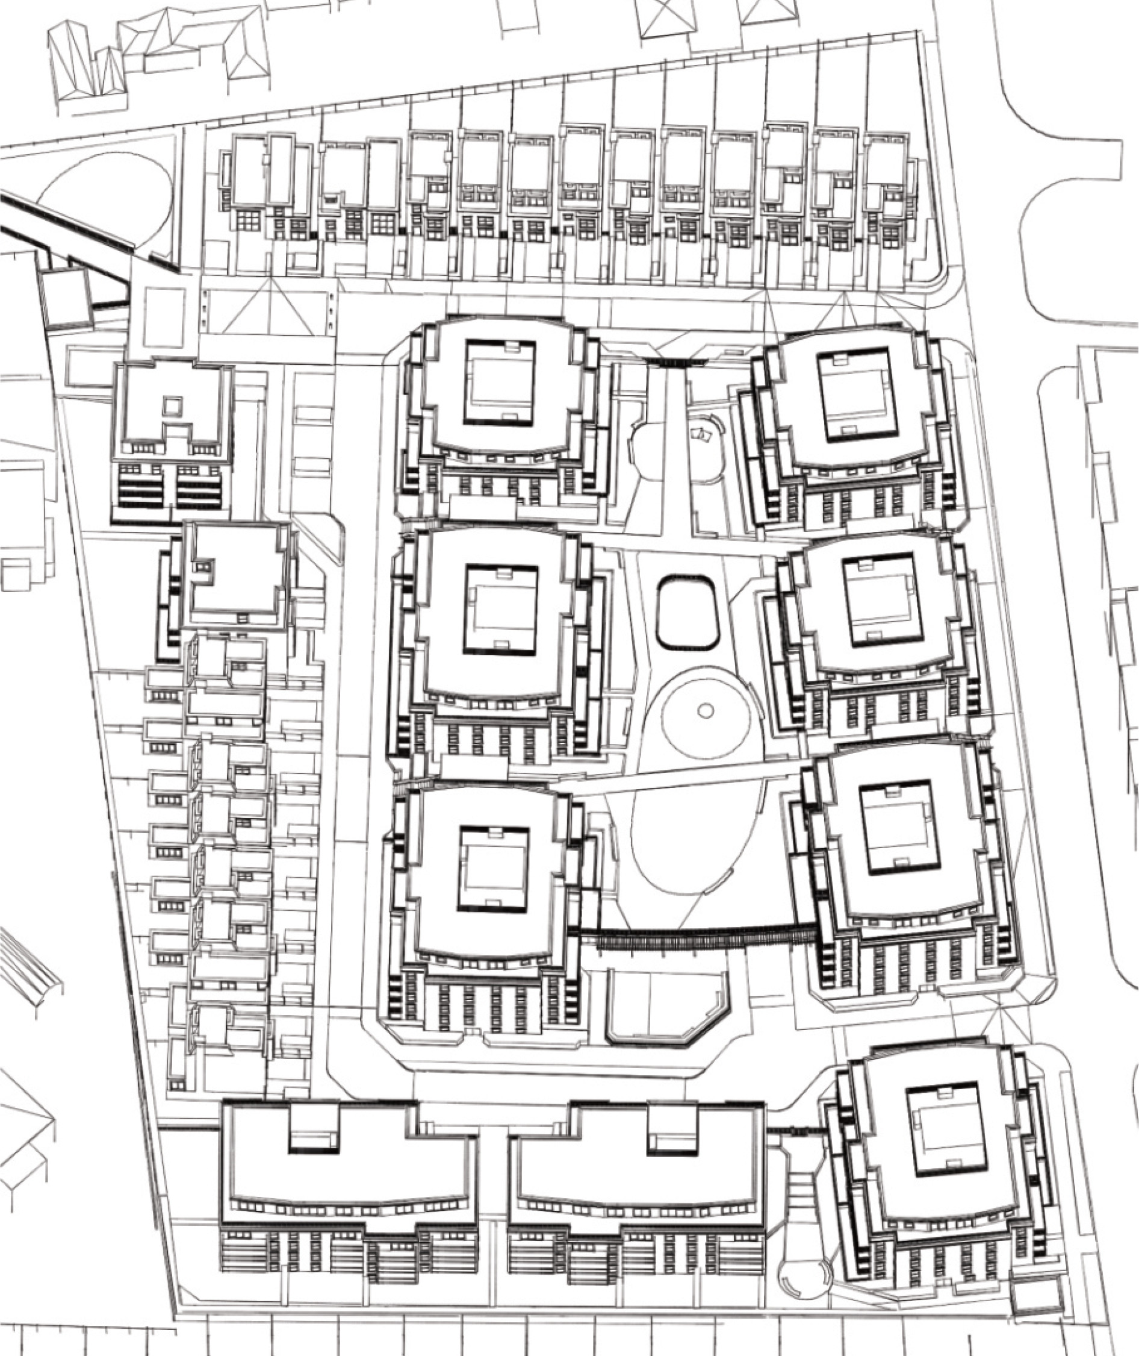
Emerging layout
Above: plan of proposed layout

Slide 6
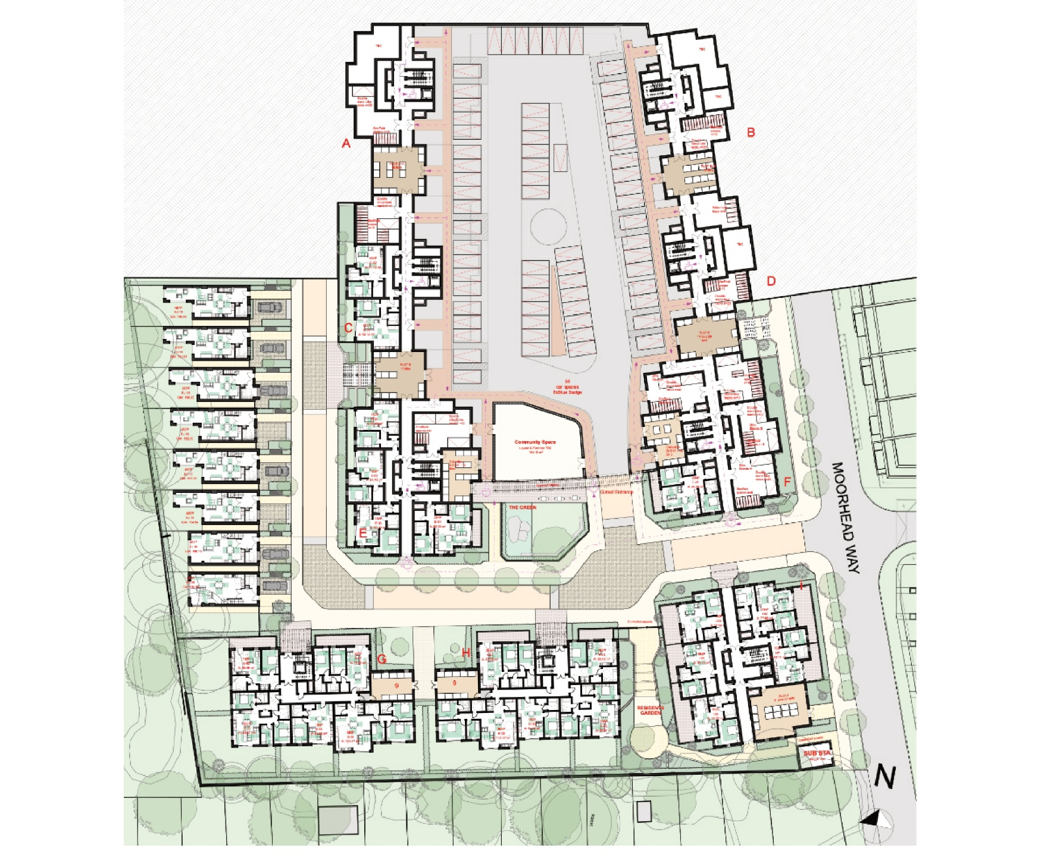
Access & parking provision
Above: accessibility plan

Slide 7
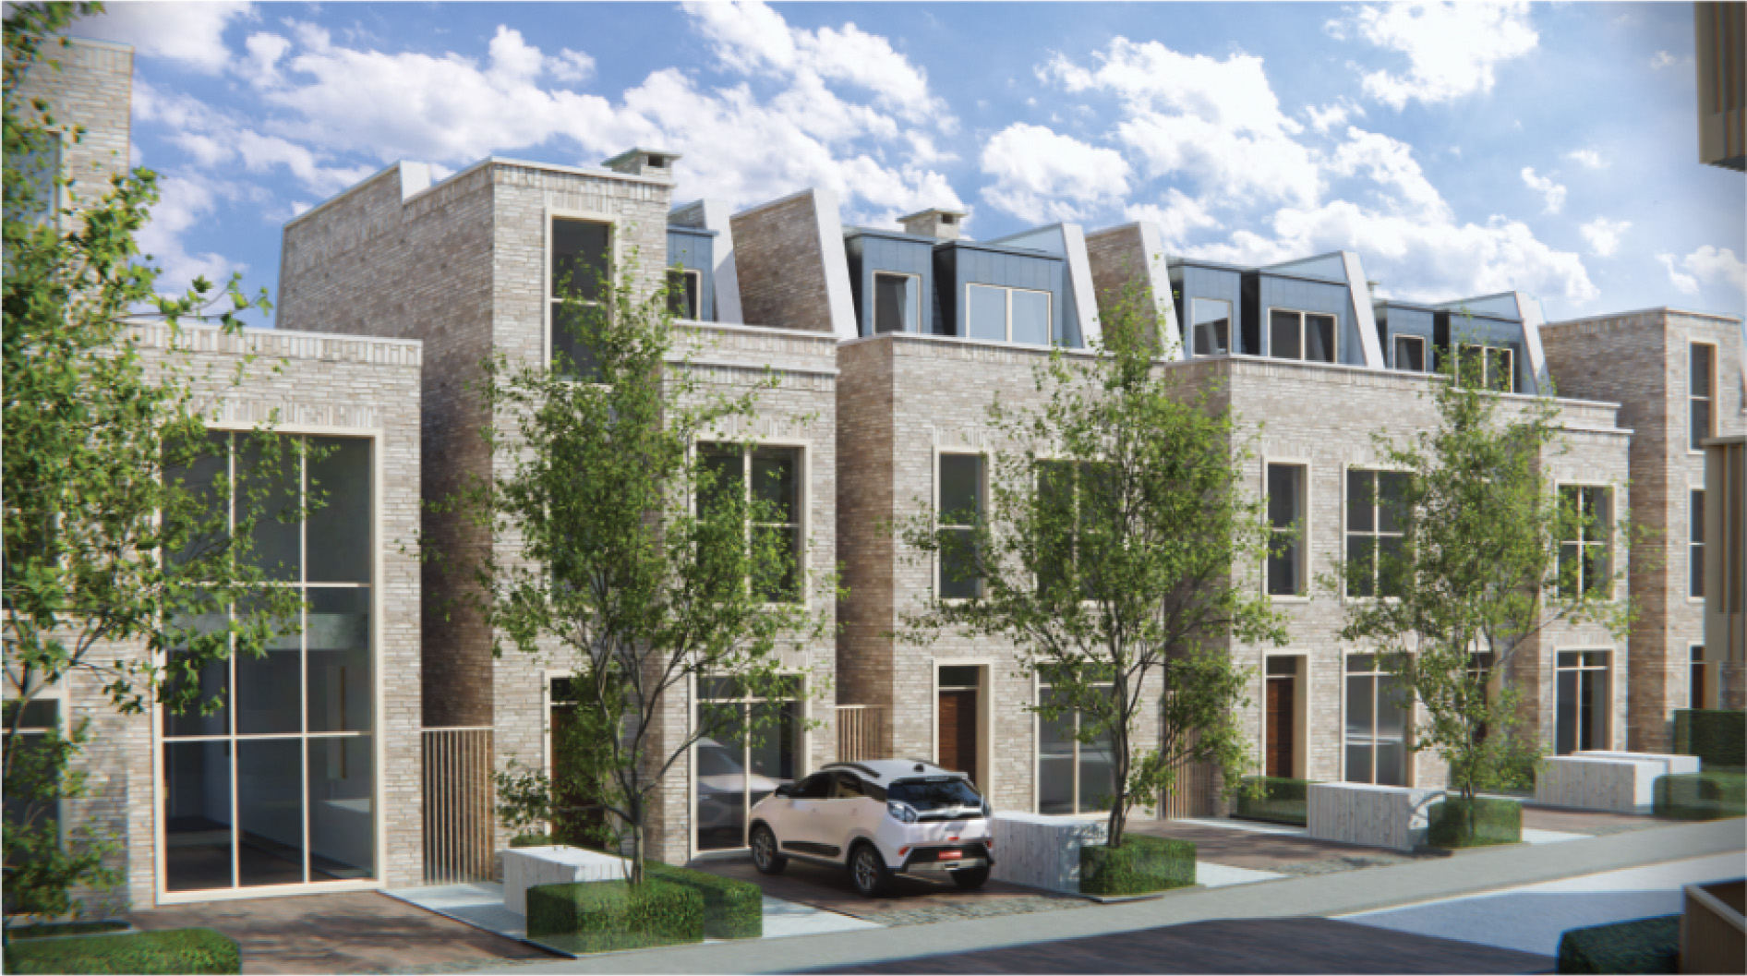
Emerging proposals
Above: Image of proposed houses

Slide 8
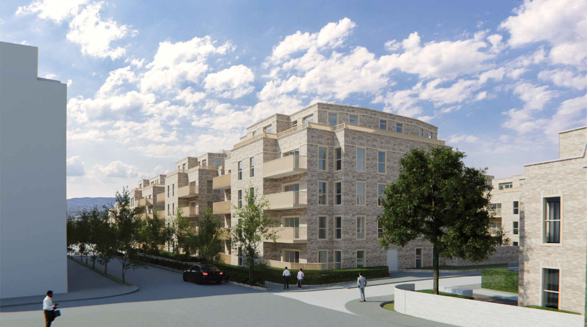
Emerging proposals
Above: Image of proposed apartments

Slide 9
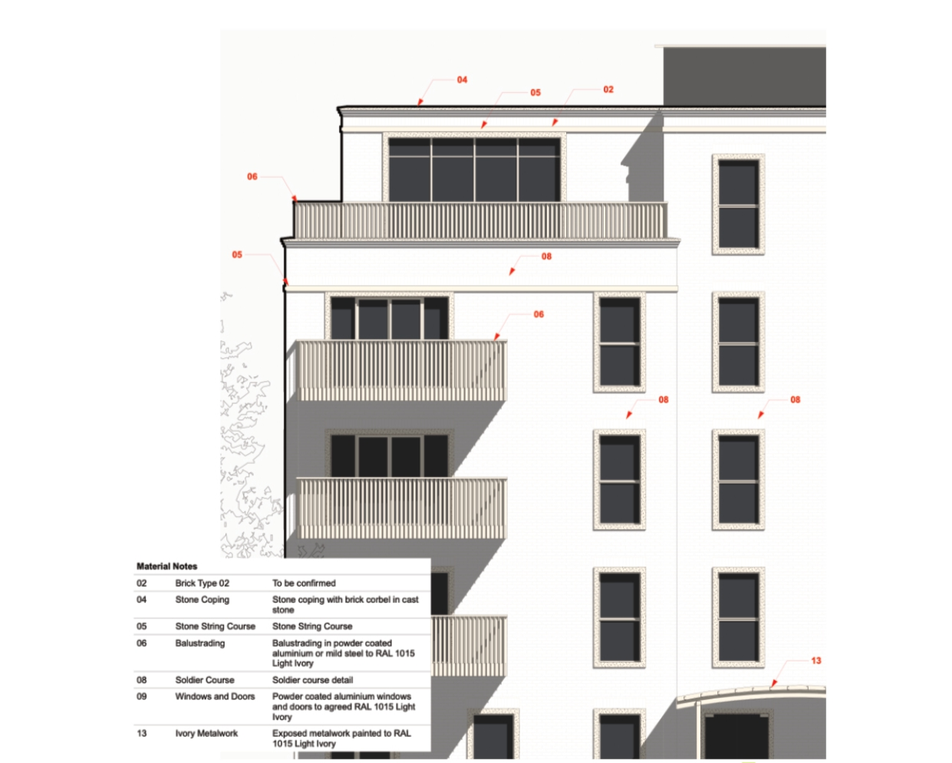
Architectural approach

Slide 10
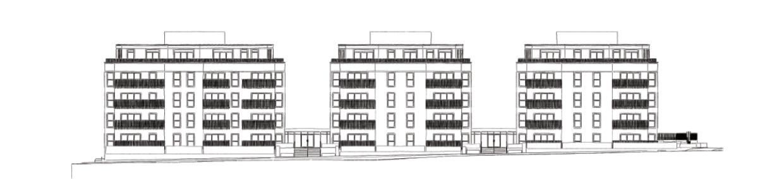
Elevation sketches
Above: elevation sketches of proposed apartments

Slide 11
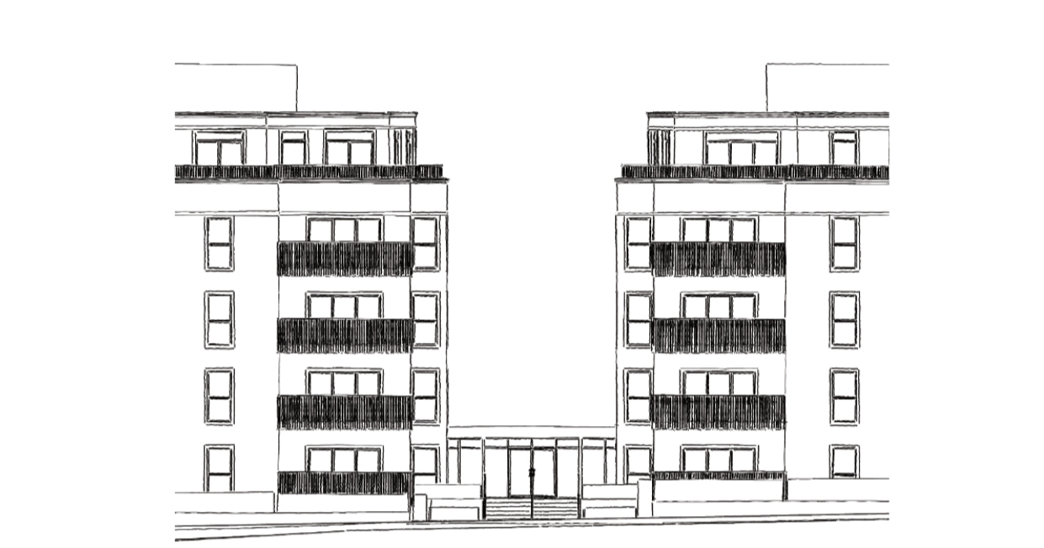
Elevation sketches
Above: elevation sketches of proposed apartments

Slide 12
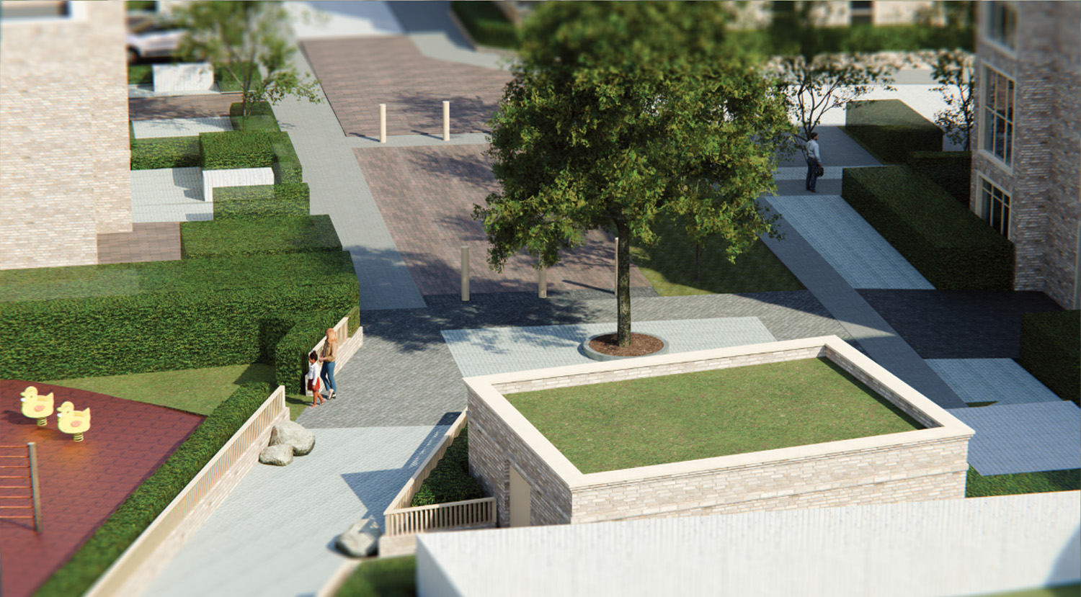
Proposed green spaces

Slide 13
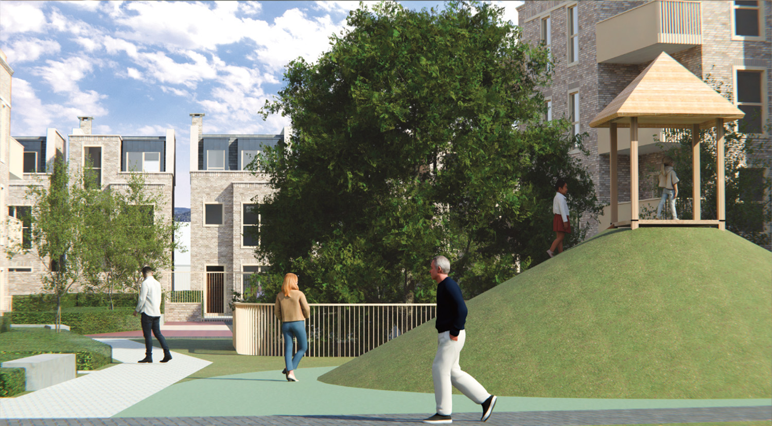
Proposed green spaces

Slide 14
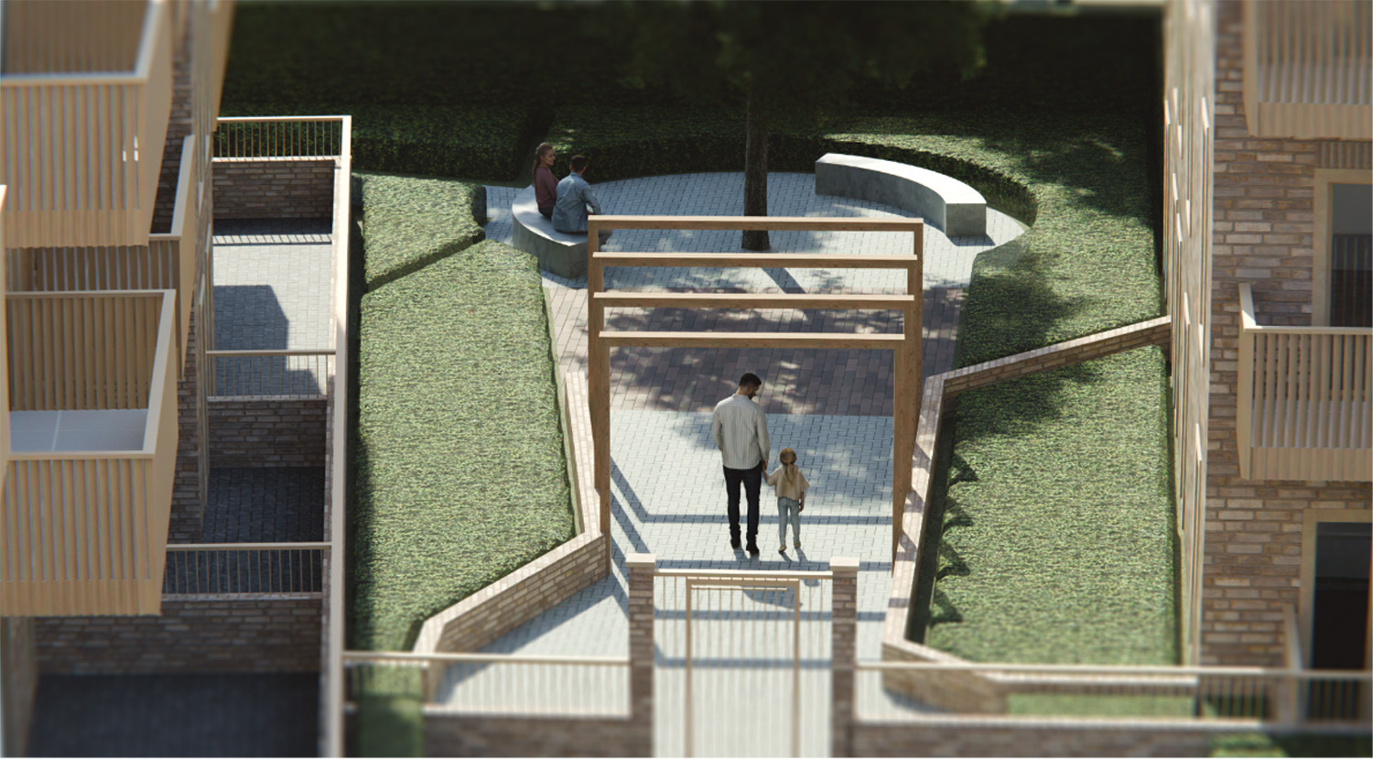
Proposed green spaces

Slide 15
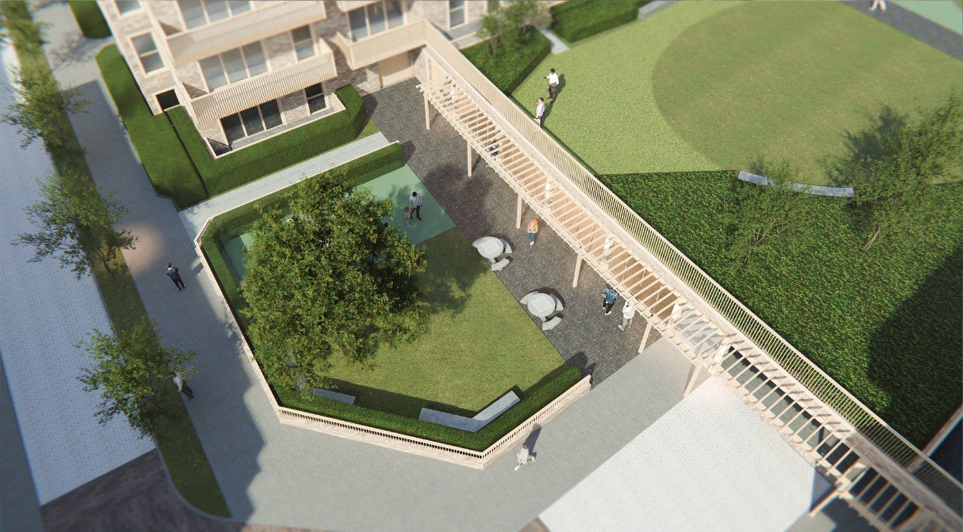
Proposed green spaces

Slide 16
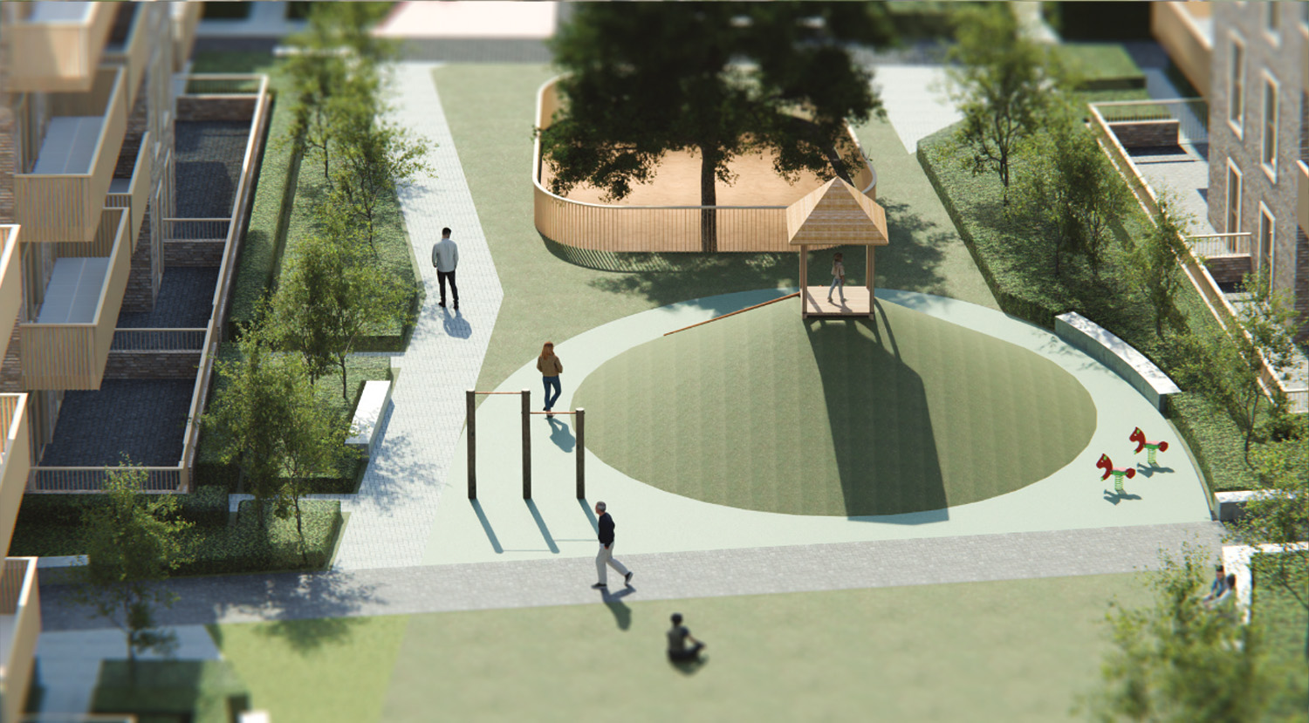
Proposed green spaces

Slide 17
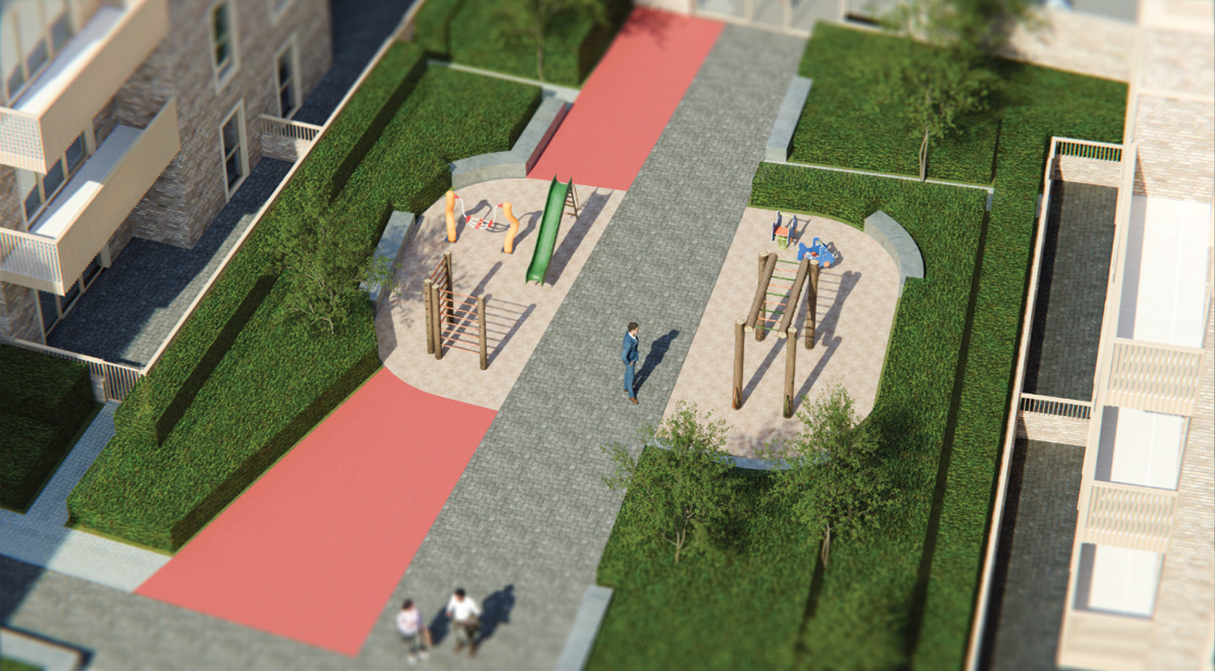
Proposed green spaces

Slide 18
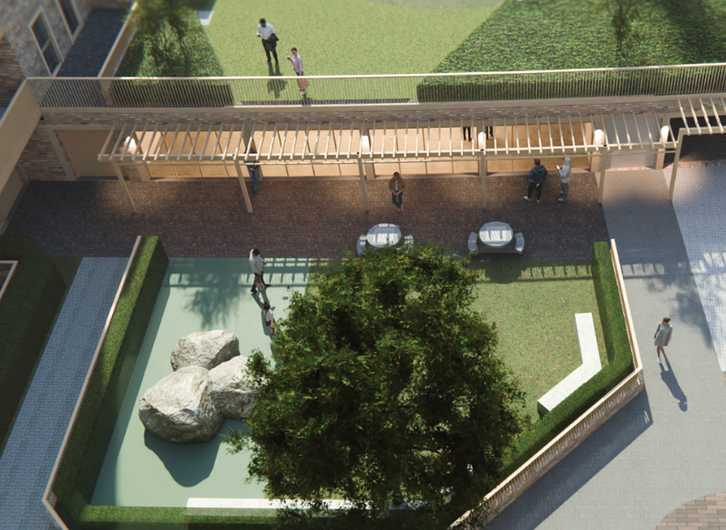
Proposed green spaces

Slide 19
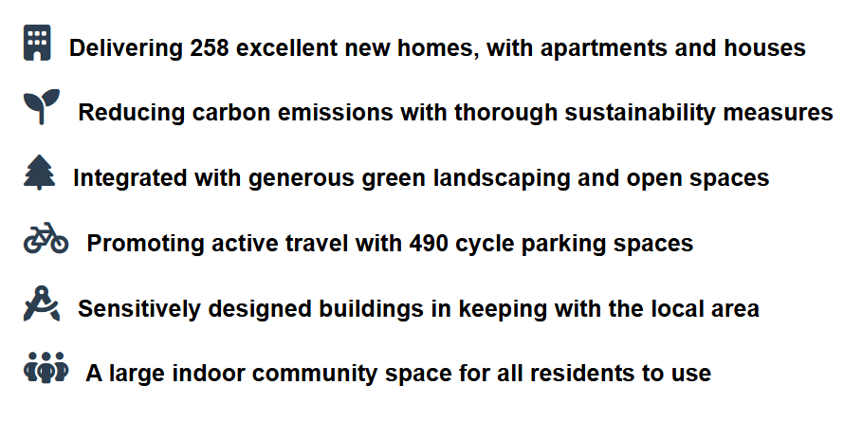
Benefits

Slide 20




Thank you
Derreb Limited

